Slide 1


PowerShell Core Concept: Making sense of this Function Thing️
Phil Bossman
PowerShell enthusiast and Citrix Architect in Raleigh, NC
PowerShell Conference Book Vol 2
Research Triangle PowerShell User Group
Twitter: @schlauge
GitHub: https://github.com/pbossman
Website: https://schlauge.com/

Slide 2
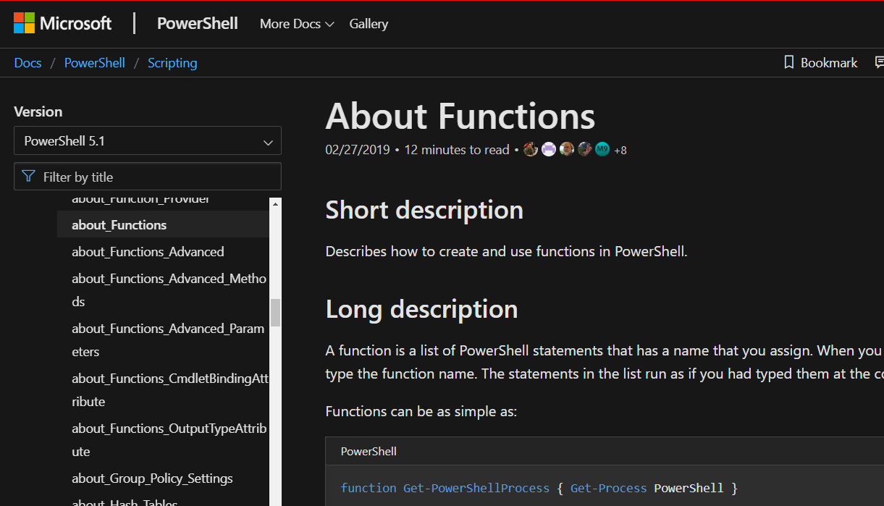
Making sense of this Function Thing
What is this function thing?
The power of PowerShell functions.
Using Advanced Functions!

